Slide 1
Database Systems
Lab 04

Slide 2
OBJECTIVES:
DATABASE OBJECTS
NAMING RULE FOR TABLE AND COLUMN OF TABLE
CREATE TABLE
DATATYPES FOR SPECIFYING COLOUMN DEFINITION
DEFINING CONSTRAINT ON TABLE
INTEGRITY CONSTRAINT
PRIMARY KEY CONSTRAINT
FOREIGN KEY CONSTRAINT
VALUE COSNTRAINT
NOT NULL CONSTRAINT
UNIQUE CONSTRAINT
CHECK CONSTRAINT
HOW TO CREATE SELF REFERENCED TABLE
INSERTING DATA INTO TABLE
IMPLICIT METHOD
EXPLICIT METHOD
ALTER TABLE
ADD COLUMN
MODIFY COLUMN
DROP COLUMN
RENAME TABLE
DROP TABLE
TRUNCATE TABLE
DROP VS TRUNCATE
DEFFERED CONSTRAINT CHECKING
CHICKEN EGG PROBLEM IN ORACLE
HOW TO GET RID OF CHICKEN EGG PROBLEM
HOW TO INSERT RECORD
HOW TO GET RID OF TABLE

Slide 3
Data Definition Language (DDL)
Data Definition Language (DDL) statements are used to define the database structure or schema.
CREATE - to create objects in the database
ALTER - alters the structure of the database
DROP - delete objects from the database
TRUNCATE - remove all records from a table, including all spaces allocated for the records are removed
RENAME - rename an object

Slide 4
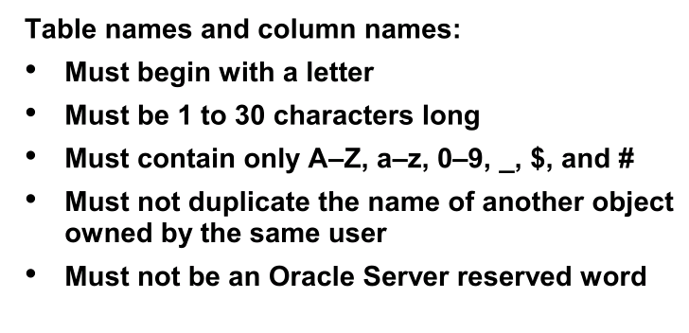
NAMING RULE

Slide 5
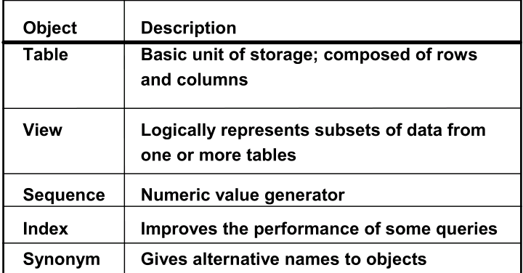
DATABASE OBJECTS

Slide 6
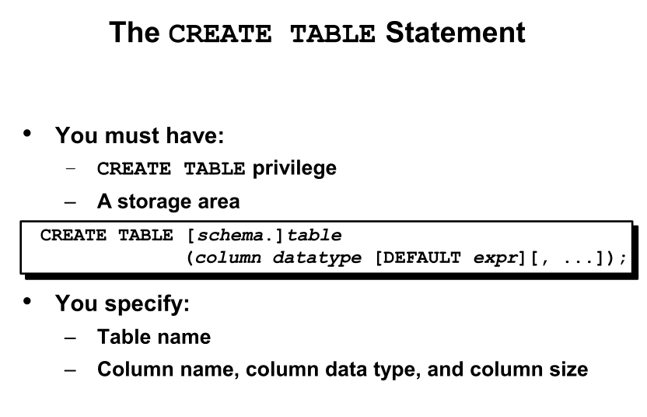
HOW TO CREATE TABLE??

Slide 7
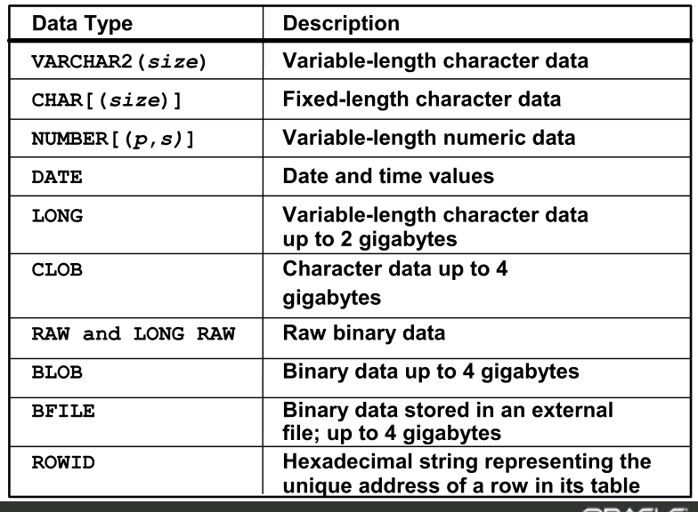
DATATYPES FOR DEFINING COLUMN

Slide 8
Creating a Table
Syntax
CREATE TABLE TABLE_NAME
(Column_name1 data_type [DEFAULT value],
Column_name2 data_type [DEFAULT value] ,
Column_name3 data_type [DEFAULT value], …..)
Example
CREATE TABLE customer
(Cust_id NUMBER(2), LastName VARCHAR2(14), FirstName VARCHAR2(14), Address VARCHAR2(20), Telno NUMBER(20));

Slide 9
Create Table from Another Table
Syntax:
CREATE TABLE table_name[colname1,colname2] AS [subquery];
Example:
The following example creates a table, DEPT30, that contains details of all employees working in department 30
CREATE TABLE dept30 AS SELECT empno, ename, sal * 12 ANNSAL, hiredate FROM emp WHERE deptno = 30;

Slide 10
Constraints in DDL
Constraints are certain restrictions over different tables/columns in a Database

Slide 11
1. Not Null Constraint
The NOT NULL constraint enforces a column to NOT accept NULL values. This means that NOT NULL constraint enforces a field to always contain a value.
Example:
CREATE TABLE customer (Cust_id NUMBER(2) NOT NULL, LastName VARCHAR2(14), FirstName VARCHAR2(14) NOT NULL, Address VARCHAR2(20), Telno NUMBER(20));

Slide 12
2. Unique Constraint
The UNIQUE constraint uniquely identifies each record in a database table. The UNIQUE and PRIMARY KEY constraints both provide a guarantee for uniqueness for a column or set of columns.
Example:
CREATE TABLE customer
(Cust_id NUMBER(2) NOT NULL UNIQUE,
LastName VARCHAR2(14),
FirstName VARCHAR2(14) NOT NULL,
Address VARCHAR2(20),
Telno NUMBER(20) UNIQUE);

Slide 13
Naming a Unique Constraint
(Cust_id NUMBER(2) NOT NULL ,
LastName VARCHAR2(14),
FirstName VARCHAR2(14) NOT NULL,
Address VARCHAR2(20),
Telno NUMBER(20) ,
CONSTRAINT uc_CidTelnum UNIQUE (Cust_id,telno));

Slide 14
Adding Unique Constraint in an Existing Table
ALTER TABLE Customer ADD UNIQUE (FirstName);

Slide 15
Dropping Unique Constraint
ALTER TABLE Customer DROP CONSTRAINT uc_CidTelnum;

Slide 16
3. Primary Key Constraint
The PRIMARY KEY constraint uniquely identifies each record in a database table
Example:
CREATE TABLE customer
(Cust_id NUMBER(2) NOT NULL PRIMARY ,
LastName VARCHAR2(14),
FirstName VARCHAR2(14) NOT NULL,
Address VARCHAR2(20),
Telno NUMBER(20));

Slide 17
Naming a Primary Key Constraint
CREATE TABLE customer
(Cust_id NUMBER(2) NOT NULL ,
LastName VARCHAR2(14),
FirstName VARCHAR2(14) NOT NULL,
Address VARCHAR2(20),
Telno NUMBER(20),
CONSTRAINTS pk_custidlname PRIMARY KEY( cust_id,LastName));

Slide 18
Primary Key Constraint using Alter Table
ALTER TABLE customer ADD PRIMARY KEY (cust_Id)
To allow naming of a PRIMARY KEY constraint, and for defining a PRIMARY KEY constraint on multiple columns,
ALTER TABLE customer ADD CONSTRAINT pk_custidlname PRIMARY KEY (Cust_id,LastName)

Slide 19
Dropping a Primary Key Constraint
ALTER TABLE customer DROP CONSTRAINT pk_custidlname

Slide 20
4. Foreign Key Constraint
A FOREIGN KEY in one table points to a PRIMARY KEY in another table.
The FOREIGN KEY constraint is used to prevent actions that would destroy links between tables.
The FOREIGN KEY constraint also prevents that invalid data from being inserted into the foreign key column, because it has to be one of the values contained in the table it points to.
Example:
CREATE TABLE EMP3 ( EMPNO NUMBER(4) NOT NULL PRIMARY KEY, DEPTNO NUMBER(7,2) NOT NULL, ENAME VARCHAR2(9) NOT NULL, CONSTRAINT FK_EMP_DEPTNO FOREIGN KEY (DEPTNO) REFERENCES DEPT(DEPTNO) );

Slide 21
Foreign Key Constraint on Existing Table
ALTER TABLE EMP3 ADD FOREIGN KEY (DEPTNO) REFERENCES DEPT(DEPTNO)
Do it Yourself:
Name the foreign key constraint using alter table
Write a command to drop this foreign key constraint

Slide 22
5. Check Constraint
Specifies a condition that must be true
Example:
CREATE TABLE EMP3
(EMPNO NUMBER(4) NOT NULL CHECK(EMPNO>0) PRIMARY KEY, DEPTNO NUMBER(7,2) NOT NULL, ENAME VARCHAR2(9) NOT NULL, CONSTRAINT FK_EMP_DEPTNO FOREIGN KEY (DEPTNO) REFERENCES DEPT(DEPTNO));

Slide 23
Naming a Check Constraint
CREATE TABLE EMP3 (EMPNO NUMBER(4) NOT NULL PRIMARY KEY, DEPTNO NUMBER(7,2) NOT NULL, ENAME VARCHAR2(9) NOT NULL, CONSTRAINT FK_EMP_DEPTNO FOREIGN KEY (DEPTNO) REFERENCES DEPT(DEPTNO) CONSTRAINT chk_EMP CHECK (EMPNO>0 AND DEPTNO=’20’));

Slide 24
6. Default Constraint
The DEFAULT constraint is used to insert a default value into a column.
The default value will be added to all new records, if no other value is specified.
Example:
CREATE TABLE EMP3 (EMPNO NUMBER(4) NOT NULL, DEPTNO NUMBER(7,2) NOT NULL, ENAME VARCHAR2(9) NOT NULL,
HIRE_DATE DATE DEFAULT GETDATE ());

Slide 25
Default Constraint using Alter Table
ALTER TABLE EMP3 MODIFY hire_date DEFAULT GETDATE ()

Slide 26
Dropping a Default Constraint
ALTER TABLE EMP3 ALTER COLUMN HIRE_DATE DROP DEFAULT

Slide 27
Detailed Example
CREATE TABLE DEPT (
DEPTNO NUMBER(2) constraint DEPT_DEPTNO_PK PRIMARY KEY,
DNAME VARCHAR2(14),
LOC VARCHAR2(13),
CONSTRAINT DEPT_DNAME_UK UNIQUE(DNAME));
CREATE TABLE EMP3 (
EMPNO NUMBER(4) CONSTRAINT EMP_EMPNO_PK PRIMARY KEY,
ENAME VARCHAR2(10) NOT NULL,
JOB VARCHAR2(9),
MGR NUMBER(4),
HIREDATE DATE DEFAULT SYSDATE,
SAL NUMBER(7, 2),
COMM NUMBER(7, 2),
DEPTNO NUMBER(7, 2) NOT NULL,
CONSTRAINT EMP_DEPTNO_CK CHECK (DEPTNO BETWEEN 1 AND 50),
CONSTRAINT EMP_DEPTNO_FK FOREIGN KEY (DEPTNO) REFERENCES DEPT(DEPTNO));

Slide 28
Drop Statement
The DROP TABLE statement is used to delete a table.
Syntax:
DROP TABLE table_name;
The DROP DATABASE statement is used to delete a database.
Syntax:
DROP DATABASE database_name;

Slide 29
Truncate Table Statement
If we just want to delete the data and not the table itself we use Truncate statement
Syntax
TRUNCATE TABLE table_name

Slide 30
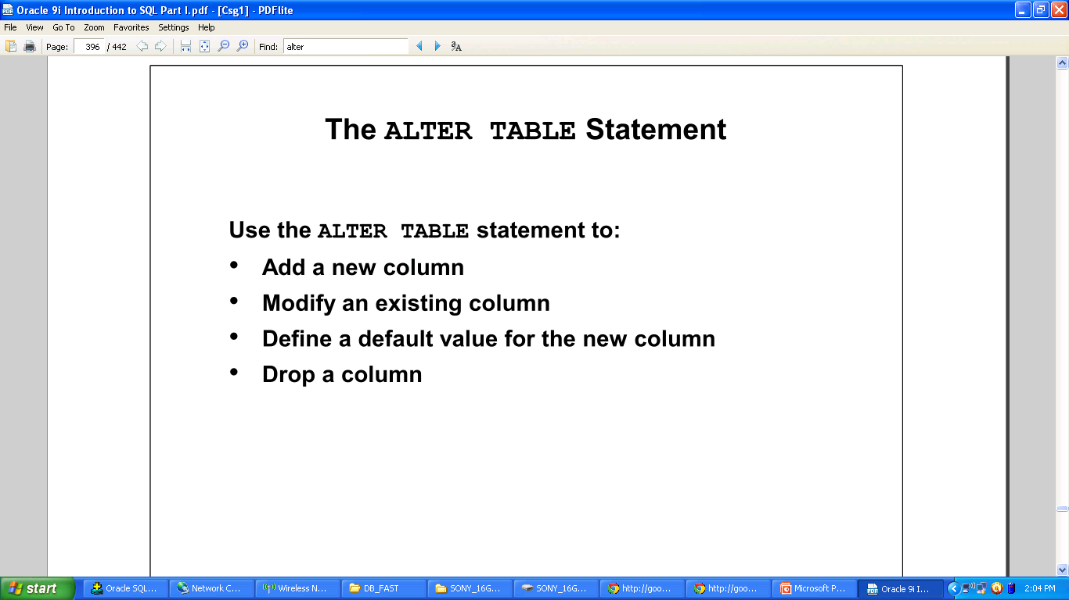
ALTER STATEMENT

Slide 31
Alter Table Statement
TO ADD A COLUMN IN A TABLE
ALTER TABLE table_name ADD column_name datatype
TO DELETE A COLUMN IN A TABLE
ALTER TABLE table_name DROP COLUMN column_name
TO CHANGE THE DATA TYPE OF A COLUMN IN A TABLE
ALTER TABLE table_name MODIFY column_name datatype

Slide 32
ADD COLUMN
SYNTAX
ALTER TABLE
STUDENT
ADD
ADDRESS(VARCHAR(23))

Slide 33
MODIFY COLUMN
SYNTAX
ALTER TABLE
STUDENT
MODIFY
ADDRESS(CHAR(10))

Slide 34
DROP COLUMN
SYNTAX
ALTER TABLE
STUDENT
DROP
ADDRESS(CHAR(10))

Slide 35
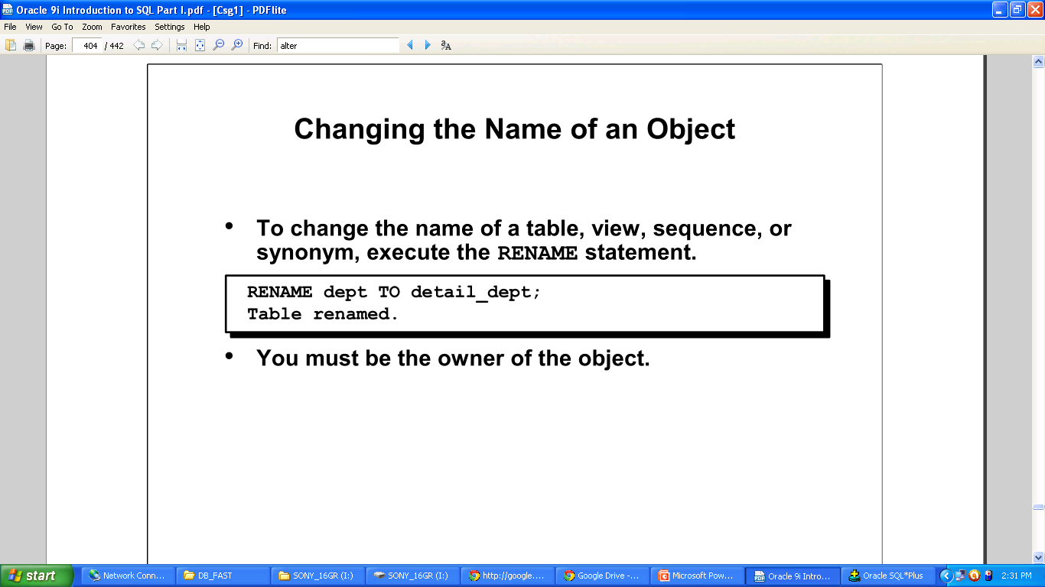
RENAME A TABLE

Slide 36
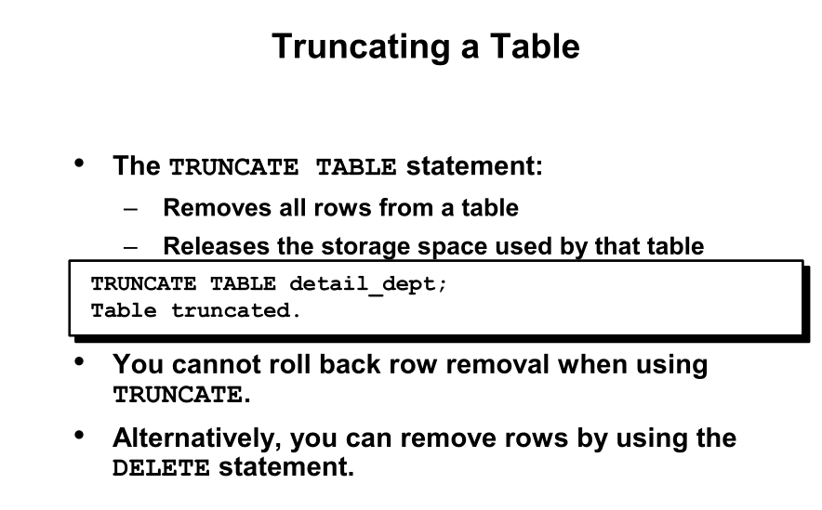
TRUNCATE A TABLE

Slide 37
DROP VS TRUNCATE
USING DROP
DROP command completely remove the table so all rows are deleted automatically.
Not only it deletes all the rows but also it deletes the table structure, views etc.
DROP command does not trigger any DML operation.
The operation of DROP cannot be rolled back. So, when you will execute DROP command always be careful of it's operation.

Slide 38
Unique Key vs Primary Key
1) Unique key in a table can be null, but primary key can not be null in any table in relational database like MySQL , Oracle etc. 2) Primary key can be combination of more than one unique keys in same table.
3) There can be only one primary key per table in a relation database e.g. MySQL, Oracle or Sybase, but there can be more than one unique key per table. 4) Unique key is represented using unique constraint while primary key is created using primary key constraint in any table and it automatically gets unique constraint. 5) Many database engine automatically puts clustered index on primary key and since you can only have one clustered index per table, it’s not available to any other unique key at same time.

Slide 39
Referential Integrity
Referential integrity is a property of data which, when satisfied, requires every value of one attribute (column) of a relation (table) to exist as a value of another attribute in a different (or the same) relation (table).
It is imposed through Primary and Foreign Key Constraints
It is violated through Delete and Update statements

Slide 40
Actions Defined by Referential Integrity Constraints
Delete/Update No Action
The No Action (default) option specifies that referenced key values cannot be updated or deleted if the resulting data would violate a referential integrity constraint. For example, if a primary key value is referenced by a value in the foreign key, then the referenced primary key value cannot be deleted because of the dependent data.
Delete/Update Cascade
A delete cascades when rows containing referenced key values are deleted, causing all rows in child tables with dependent foreign key values to also be deleted. For example, if a row in a parent table is deleted, and this row's primary key value is referenced by one or more foreign key values in a child table, then the rows in the child table that reference the primary key value are also deleted from the child table.
Delete/Update Set Null
A delete sets null when rows containing referenced key values are deleted, causing all rows in child tables with dependent foreign key values to set those values to null. For example, if employee_id references manager_id in the TMP table, then deleting a manager causes the rows for all employees working for that manager to have their manager_id value set to null.

Slide 41
Deferred Constraint Checking
Sometimes it is necessary to defer the checking of certain constraints, most commonly in the "chicken-and-egg" problem. Suppose we want to say:
CREATE TABLE chicken (cID INT PRIMARY KEY, eID INT REFERENCES egg(eID));
CREATE TABLE egg(eID INT PRIMARY KEY, cID INT REFERENCES chicken(cID));
But if we simply type the above statements into Oracle, we'll get an error. The reason is that the CREATE TABLE statement for chicken refers to table egg, which hasn't been created yet! Creating egg won't help either, because egg refers to chicken.

Slide 42
Getting Rid of the Problem
To work around this problem, we need SQL schema modification commands. First, create chicken and egg without foreign key declarations:
CREATE TABLE chicken(cID INT PRIMARY KEY, eID INT);
CREATE TABLE egg(eID INT PRIMARY KEY, cID INT);
Then, we add foreign key constraints:
ALTER TABLE chicken ADD CONSTRAINT chickenREFegg FOREIGN KEY (eID) REFERENCES egg(eID)
INITIALLY DEFERRED DEFERRABLE;
ALTER TABLE egg ADD CONSTRAINT eggREFchicken FOREIGN KEY (cID) REFERENCES chicken(cID)
INITIALLY DEFERRED DEFERRABLE;

Slide 43
Defining Initially Deferred Deferrable
INITIALLY DEFERRED DEFERRABLE tells Oracle to do deferred constraint checking.
For example, to insert (1, 2) into chicken and (2, 1) into egg, we use:
INSERT INTO chicken VALUES(1, 2);
INSERT INTO egg VALUES(2, 1);
COMMIT;
Because we've declared the foreign key constraints as "deferred", they are only checked at the commit point. (Without deferred constraint checking, we cannot insert anything into chicken and egg, because the first INSERT would always be a constraint violation.)

Slide 44
Dropping the Tables
Finally, to get rid of the tables, we have to drop the constraints first, because Oracle won't allow us to drop a table that's referenced by another table.
ALTER TABLE egg DROP CONSTRAINT eggREFchicken;
ALTER TABLE chicken DROP CONSTRAINT chickenREFegg;
DROP TABLE egg;
DROP TABLE chicken;

